Slide 1





Project 1: Machine Learning Internship
Salary Prediction for
Data Professions
Zafar Abdugafforov
Batch name: MIP-ML-12

Slide 2

Problem Statement:
Salaries in the field of data professions vary widely based on factors such as experience, job roles and performance.
Accurately predicting salaries for data professionals is essential for both job seekers and employers.

Slide 3
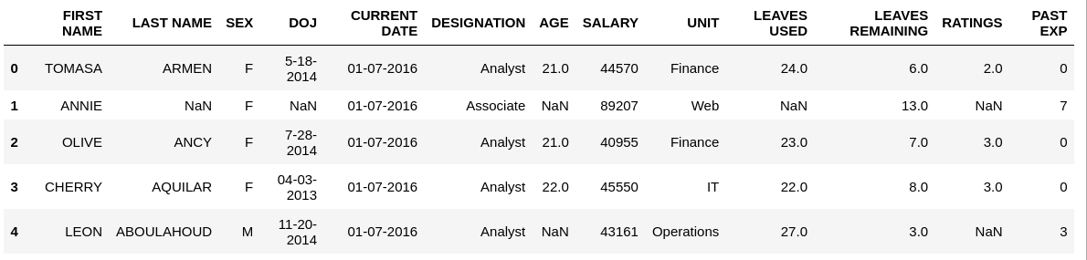
Project Overview
The project analyzed a dataset comprising 2639 entries with 13 columns, containing information such as first name, last name, sex, date of joining, current date, designation, age, salary, unit, leaves used, leaves remaining, ratings, and past experience. The exploratory data analysis (EDA) involved assessing the data's shape, summary statistics, and identifying missing values, which were subsequently filled with appropriate values.

Slide 4
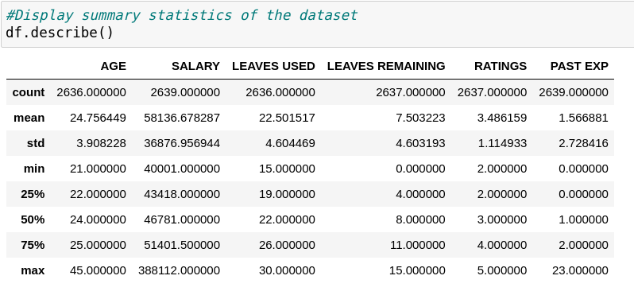
Key Findings from Exploratory Data Analysis
The average salary ranges distinctly across different designations, with directors commanding the highest average salary.

Slide 5
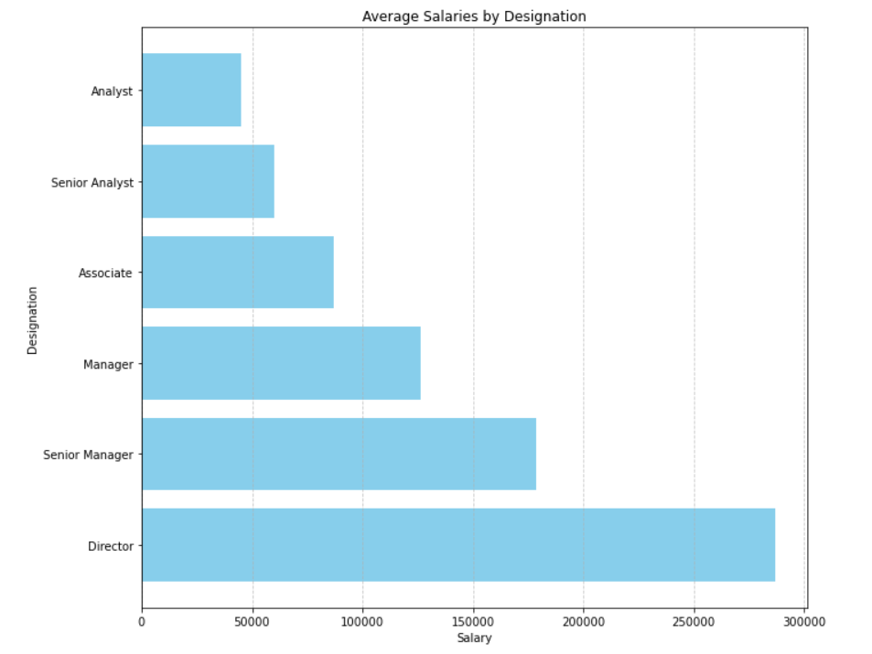
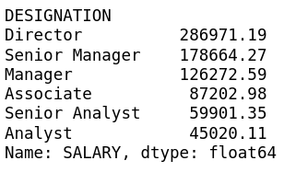
The distribution of salaries

Slide 6
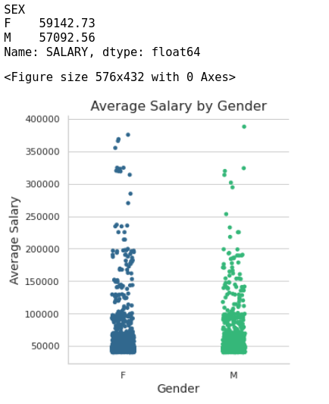
The average salary by Gender
The Average Salary differs based on gender: with females earning a slightly higher average salary compared to males.

Slide 7
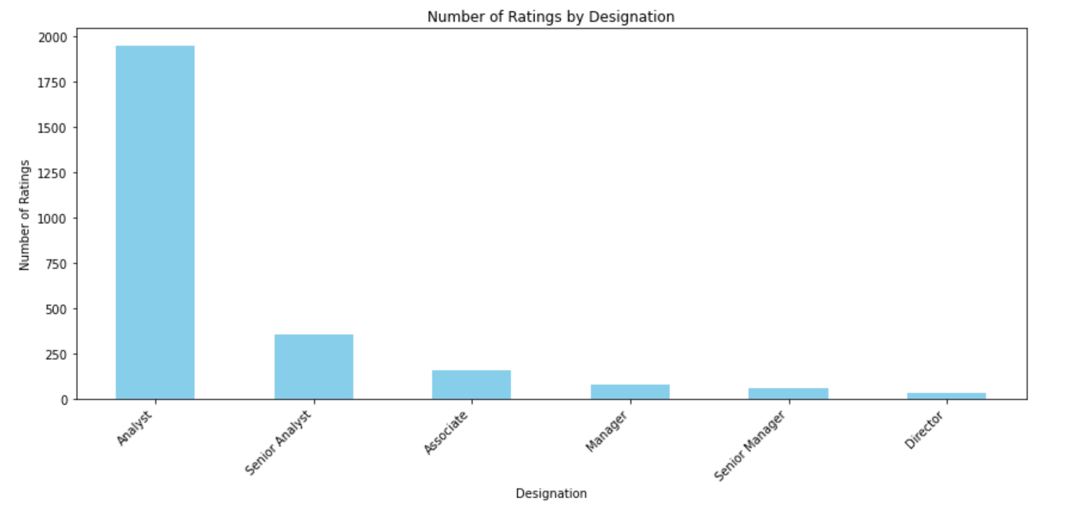
Distribution of Ratings by Designation
Representation of the number of ratings by designation showcases Analysts (1949) as the highest, followed by Senior Analysts (356), Associates (159), Managers (81), Senior Managers (62), and Directors (32).

Slide 8
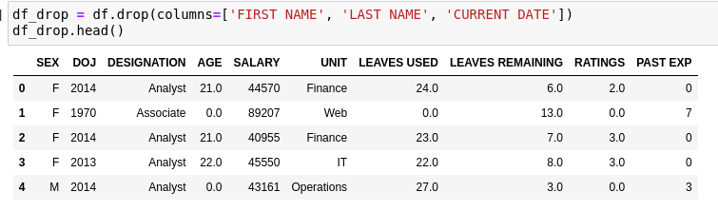
Feature Engineering and Data Preprocessing
In this step, new features were created or existing ones transformed to provide additional insights and improve model performance. This included the calculation of years of experience, job tenure, and the creation of a performance index.

Slide 9
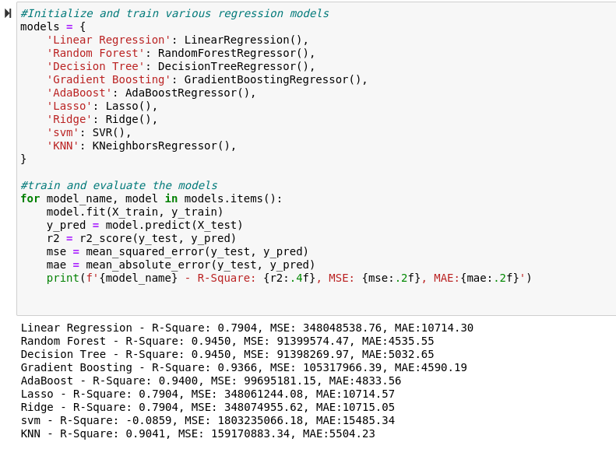
Machine Learning Model Development
Various regression models were trained to predict salaries, including linear regression, decision trees, random forests, gradient boosting, among others. These models were a pivotal part of the project in forecasting salaries accurately.

Slide 10
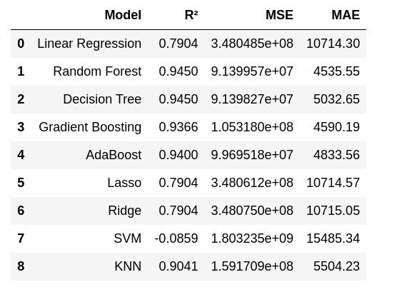
Summary:
Top Performing Models:
The Random Forest and Decision Tree models exhibit the highest R² values (0.9450), suggesting they account for approximately 94.5% of the variance in salary predictions. Additionally, they showcase the lowest MSE values (91,399,574.47 and 91,398,269.97, respectively) and relatively modest MAE values (4,535.55 and 5,032.65), positioning them as the top performers among all models.

Slide 11
Recommendations:
For accurate salary predictions in this task, Random Forest and Decision Tree are suggested for their high accuracy and minimal error rates. Consider Gradient Boosting and AdaBoost as viable options. Linear models may be too basic for this dataset, while SVM showed poor performance and should be avoided. Prioritize models with superior performance metrics to enhance the accuracy of salary predictions and gain deeper insights into factors affecting salaries in data-related fields.

Slide 12

Thank
You

